Slide 1
Design
Thinking for Innovation
Teaching the next Generation
VIRAJITA SINGH
Assistant Vice Provost, Office for Equity and Diversity
Sr. Research Fellow/Adjunct Assistant Professor, COLLEGE OF DESIGN

Slide 2
Context

Slide 3
InFluences
Change by Design Tim Brown
A Whole New Mind Daniel Pink
In the Scheme of Things Thomas Fisher
“In a world with little respect for traditional structures, almost everything – from the operation of a company to the organization of a community – can be approached as a design problem.”
- Fisher, ‘Design in the World of Flows.’ In the Scheme of Things

Slide 4
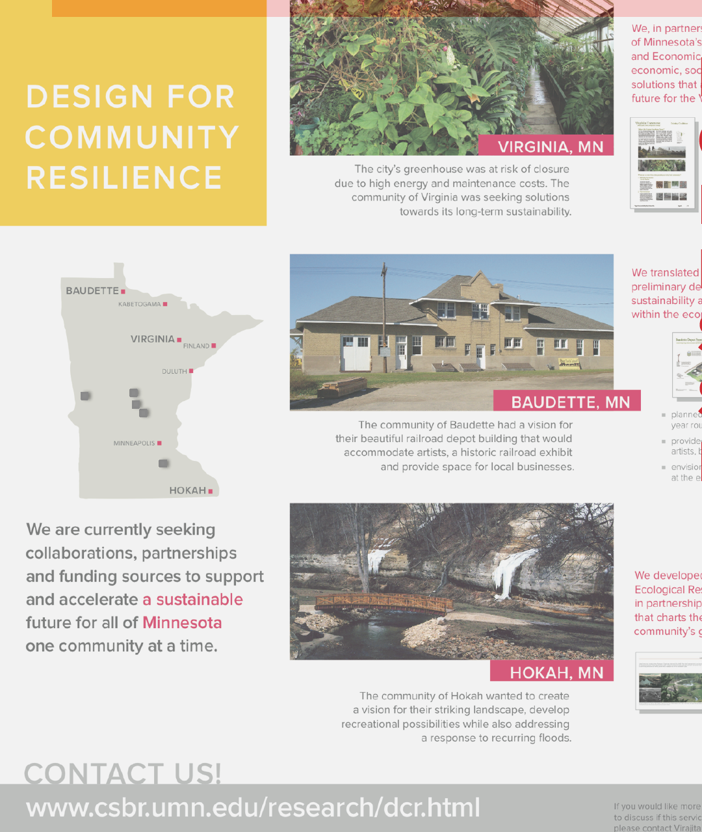
Design for community resilience

Slide 5
Definition +
Principles

Slide 6
What is Design Thinking?
Design thinking is an emerging field of practice, rooted in the tools and processes traditionally employed in design disciplines (architecture, landscape architecture, graphic design, interior design, web design, interactive design and others).

Slide 7
What is Design Thinking?
The process of design thinking involves actions such as problem definition, field research, idea generation, storyboarding, frequent prototyping and narrative as ways to engage participants and motivate creative action.

Slide 8
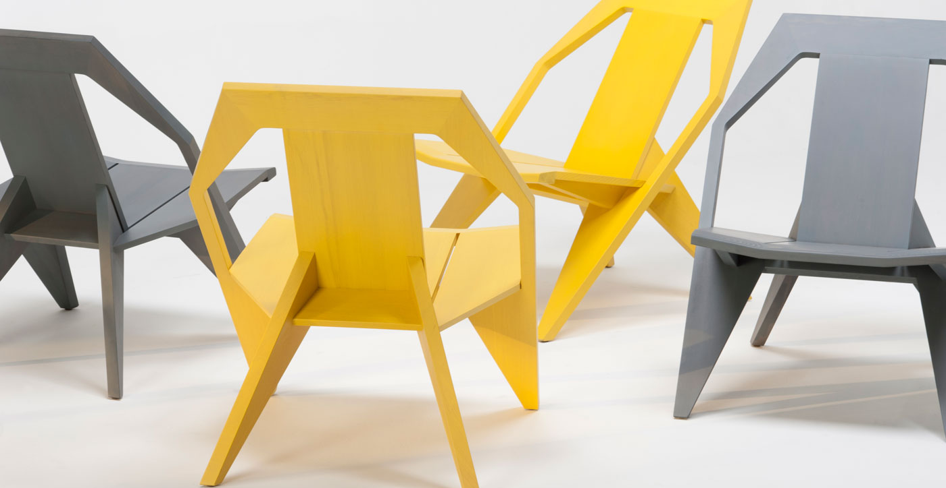
What is Design Thinking?

Slide 9
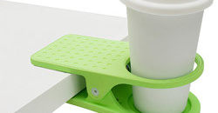
What is Design Thinking?

Slide 10
What is Design Thinking?
Design Thinking is a process.
Design Thinking is also an
emerging field.

Slide 11
What is Design Thinking?
Design Thinking uses tools and methods from design disciplines to create something new,
Or
to refine and make better something that exists.

Slide 12
What is Design Thinking?
Design seeks to function well.
Design seeks to delight.
Design seeks to innovate.
Design seeks to create beauty.

Slide 14
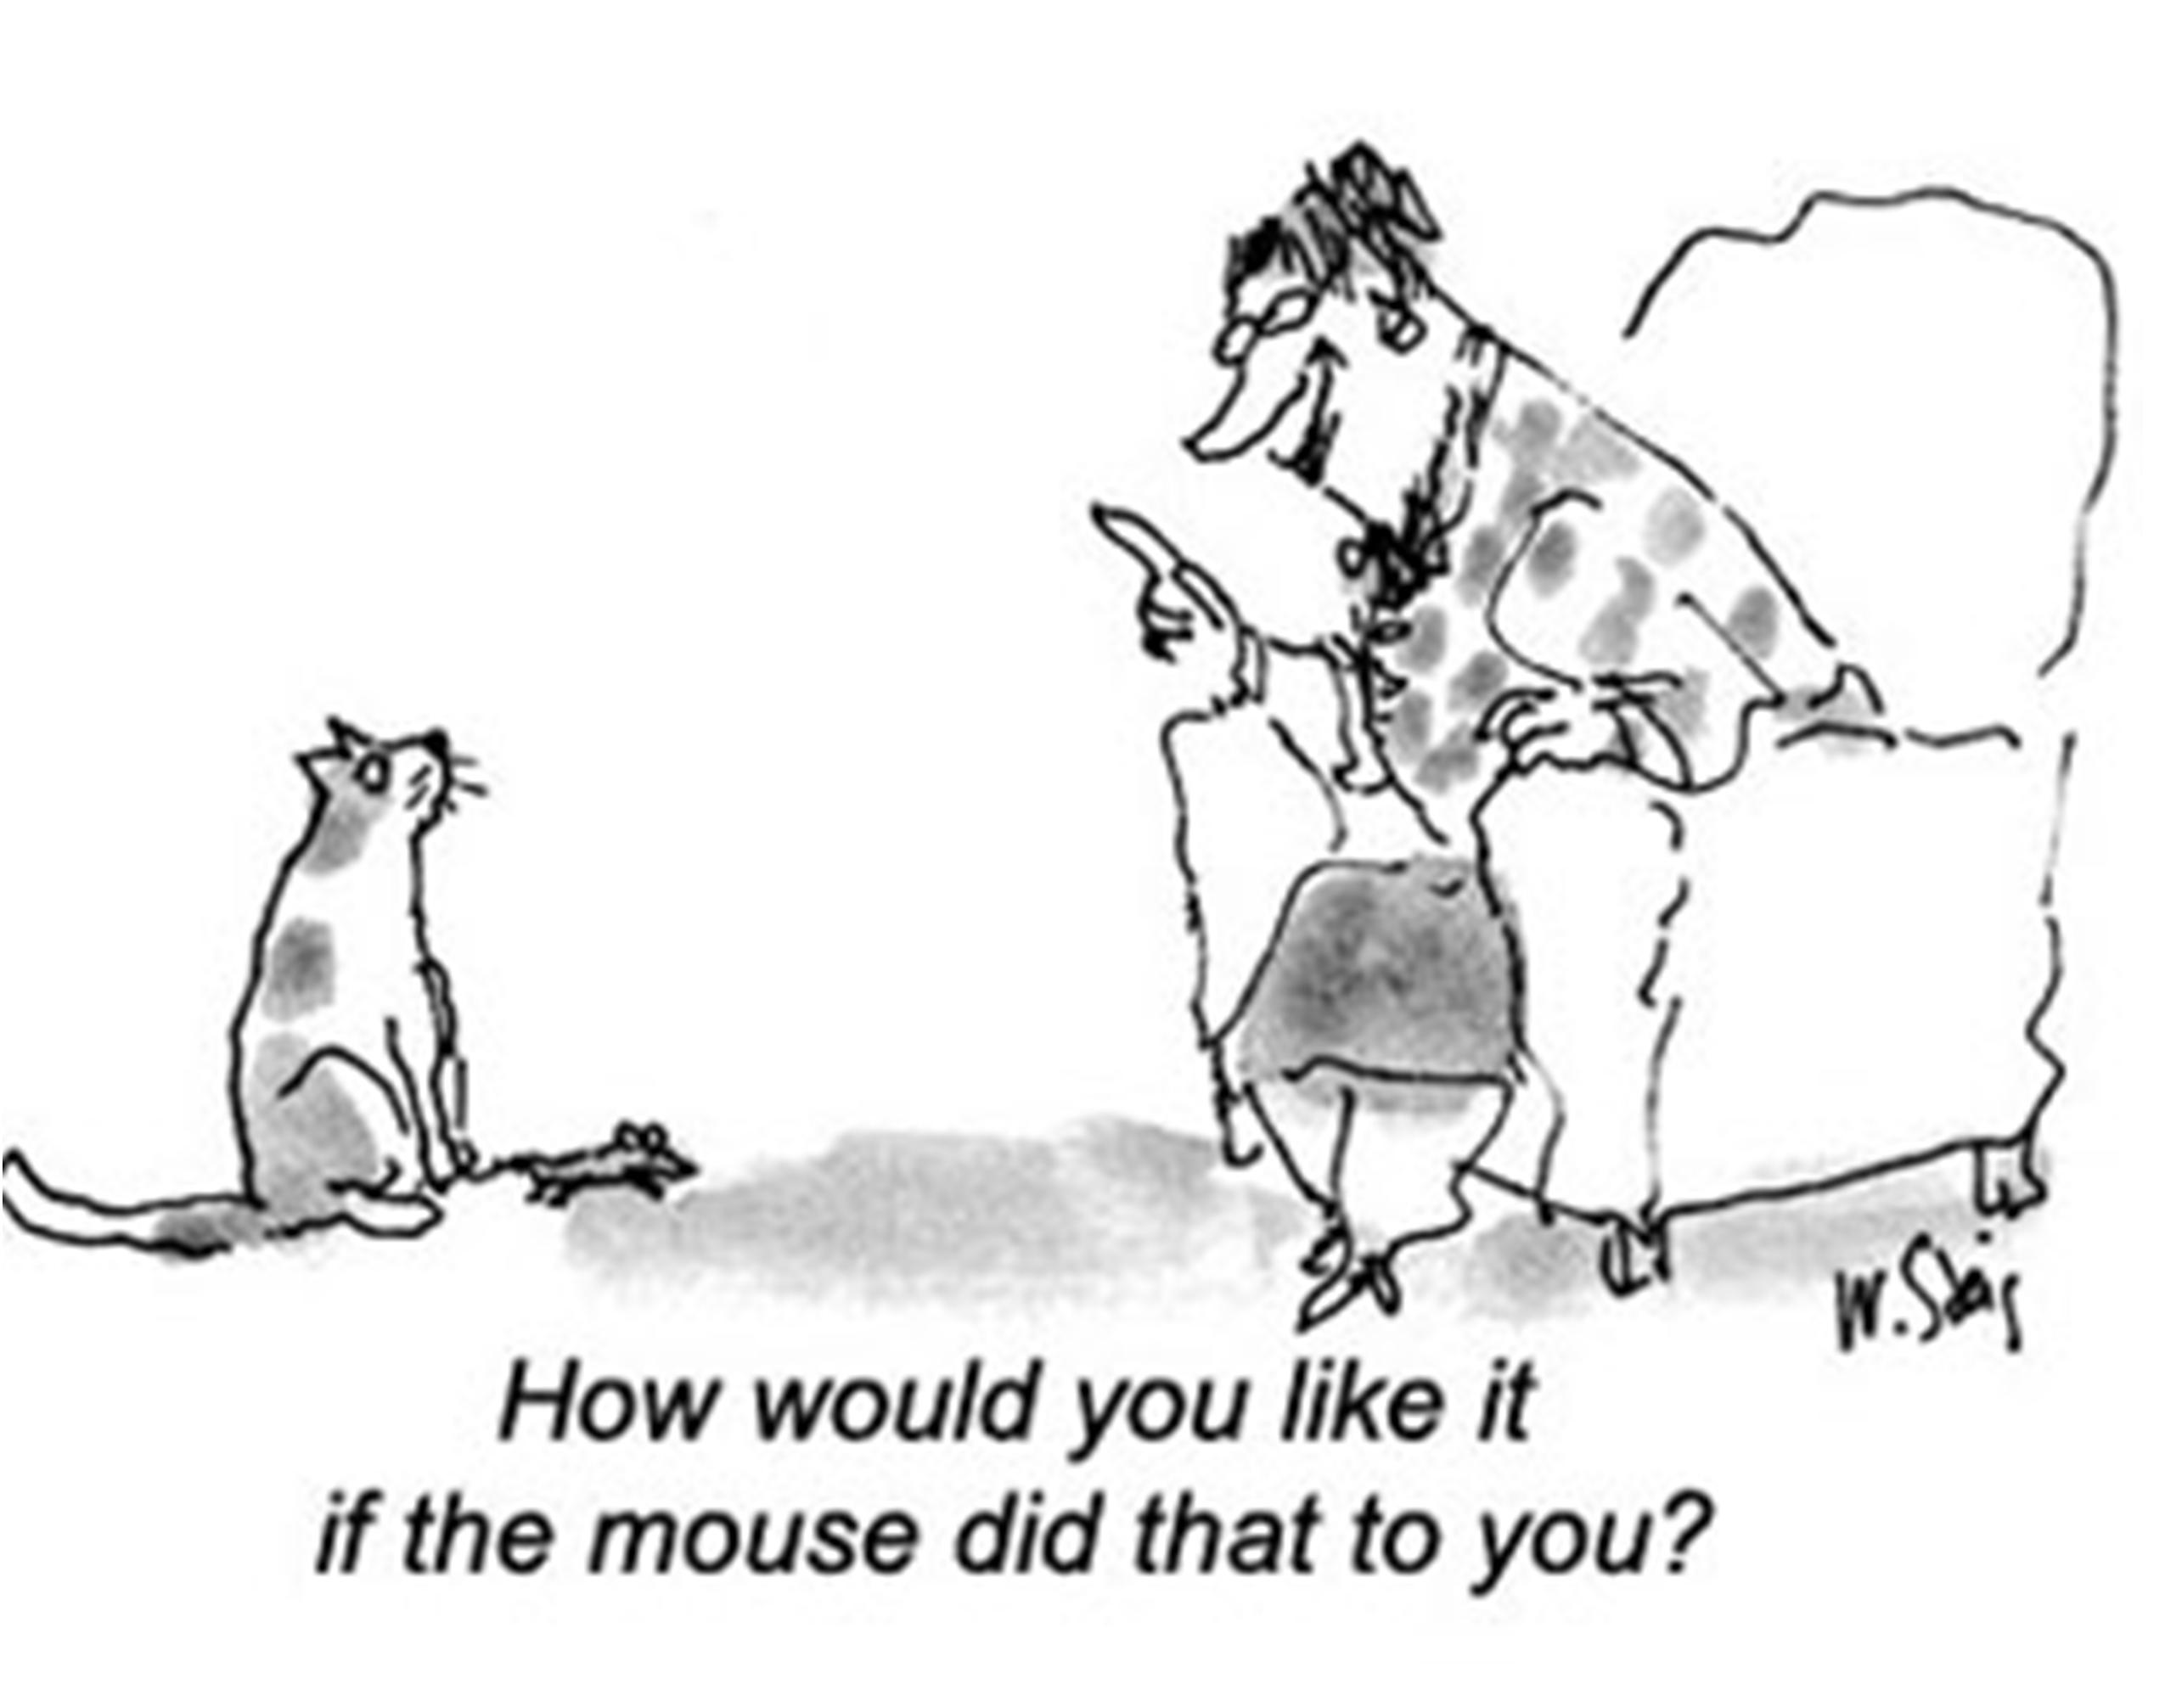
empathy

Slide 15
empathy
Users are very important in design thinking process.
Learning about the user and putting yourself in the users shoes is important.

Slide 16

ideate

Slide 17
ideate
Generating many ideas is important.
Drawing a picture to go with your idea is important.

Slide 18
prototype
Making things visible is important.
Making things (thinking with your hands) is important.

Slide 19

prototype

Slide 20
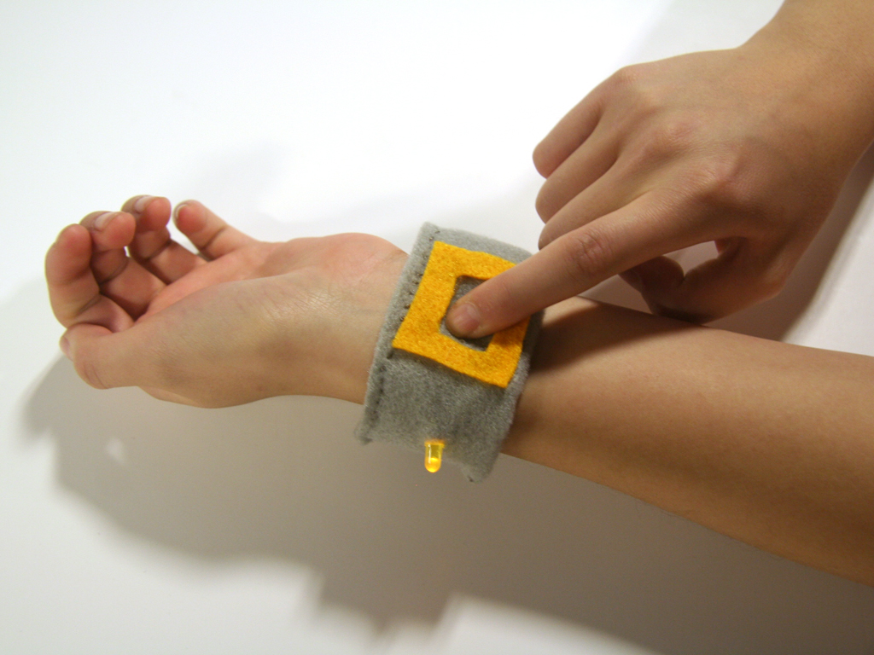
prototype

Slide 21
Eight Principles
1. Embracing diversity in all forms
2. Radical collaboration
3. Making things visible
4. Having empathy for the user

Slide 22
Eight Principles
5. Having creative confidence
6. Having a bias for action
7. Being open to failing forward
8. Committing to iterative action

Slide 23
The Course

Slide 24
Course details
Title: Design Thinking for Innovation, LS/IS 5100
Offered in: Masters of Liberal Studies/Innovation Studies certificate programs, Spring Semester, St Paul or East Bank
Students: Graduate, professionals, some undergraduate

Slide 25
Learning objectives
Title: Design Thinking for Innovation, LS/IS 5100
Offered in: Masters of Liberal Studies/Innovation Studies certificate programs, Spring Semester, St Paul or East Bank
Students: Graduate, professionals, some undergraduate

Slide 26
PURPOSE
Teaching design thinking to interdisciplinary graduate students
Teaching design thinking to students who are not necessarily immersed in design
Teaching about real world applied design thinking

Slide 27
Key assignments
Paper: Studying a designer
Paper: Self as designer
Field trips: MIA, Leonardo’s Basement
Visual Journal
Team project with Real world clients
Reflection paper

Slide 28
Client/Partners
Minneapolis of Arts
City of North St Paul
City of Minnetonka
Hennepin County Library
City of Woodbury
U of M Biomedical Library
U of M Informatics Institute
Others

Slide 29
Student work

Slide 30
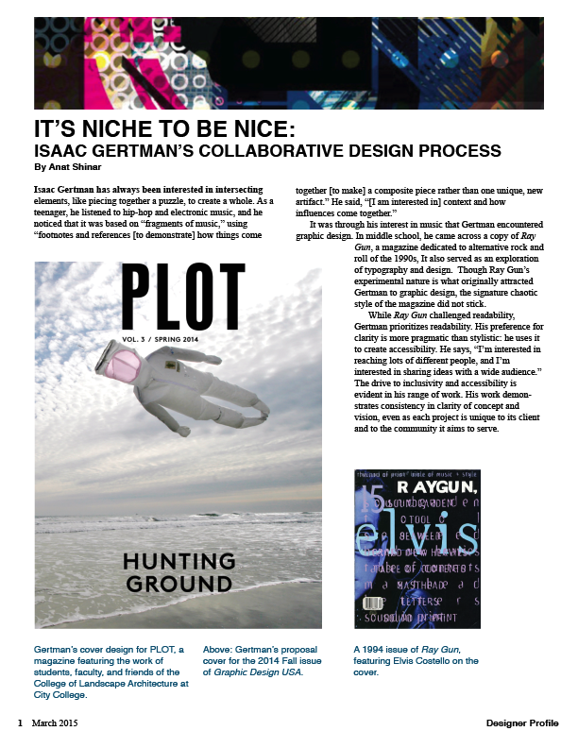
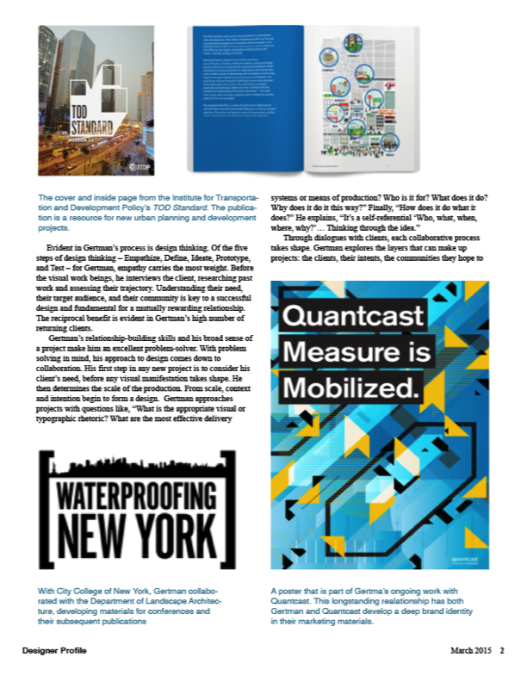
Paper 1

Slide 31
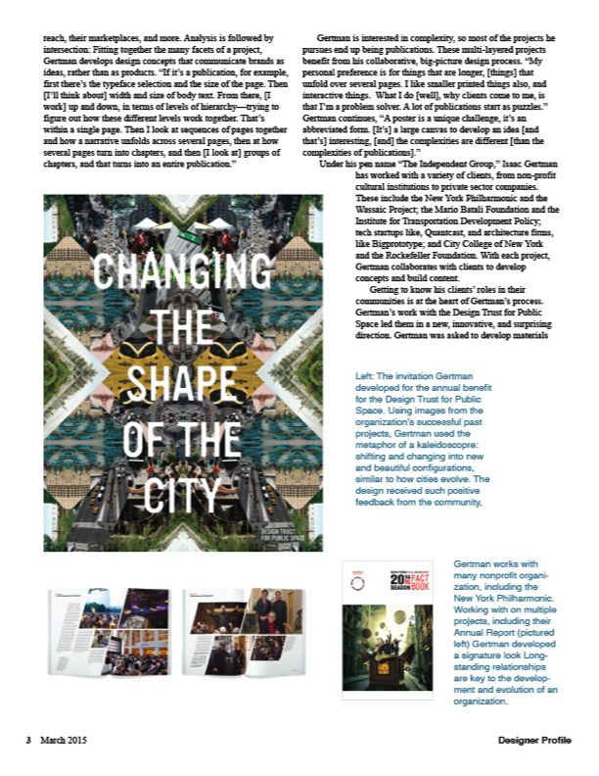
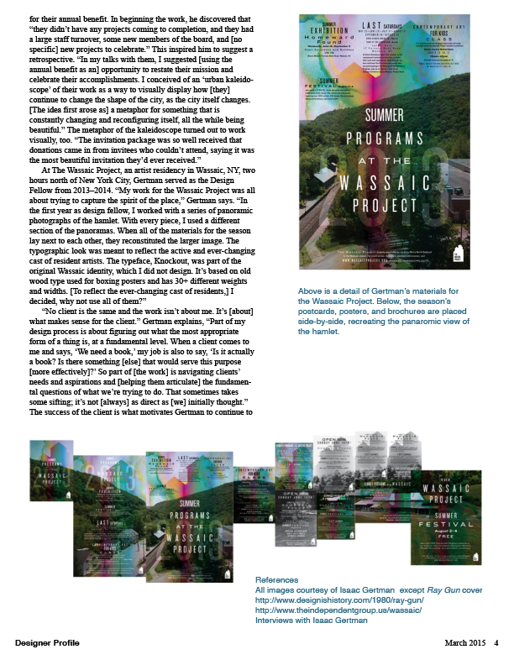
Paper 1

Slide 32

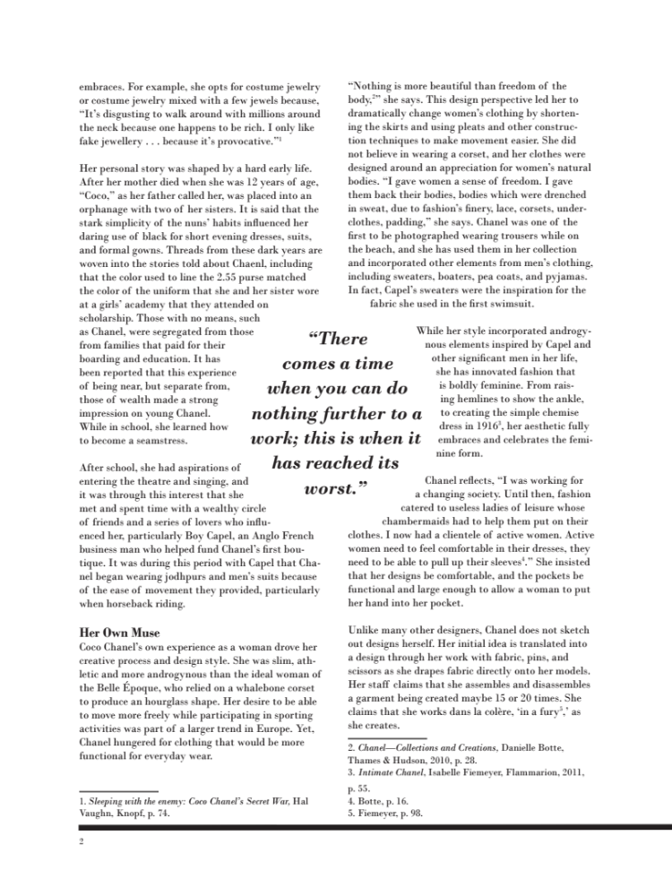
Paper 1

Slide 33


Paper 1

Slide 34
Paper 1
“Both papers were also quite challenging for the simple fact that I’ve grown overly accustomed to writing dry academic papers. I didn’t struggle with the writing of either. Writing the first felt rather straightforward, though I wished I had an extra page or two to work with. Writing the second was a fun exploration of how I might apply concepts from the course to my life and it actually got me really excited about trying to do so. The challenge, for me, came in the layout. I had wanted to learn to use InDesign, and while I’m glad I took the chance and tried it for both papers, there was a steep learning curve and I feel far from proficient. In addition to trying to teach myself to use a new software program, I also had to actually think about the layout….

Slide 35
Paper 1
…I typically write simple, double-spaced papers in Word, with at most 2 or 3 images of theoretical models or graphs scattered within. I’ve never put much thought into lines, color, spatial arrangements, or any of the other factors I had to consider in working on the paper. It felt a bit like stretching my brain in new ways. It also took several days of work before I could even tell if the layout I had created was actually pleasing to look at. I was initially so impressed by the mere fact that I could insert different images and text boxes, create colored backgrounds and generally play with the layout to a far greater degree than I was ever able to do in Word, I forgot to really consider how good it looked (or didn’t).”

Slide 36
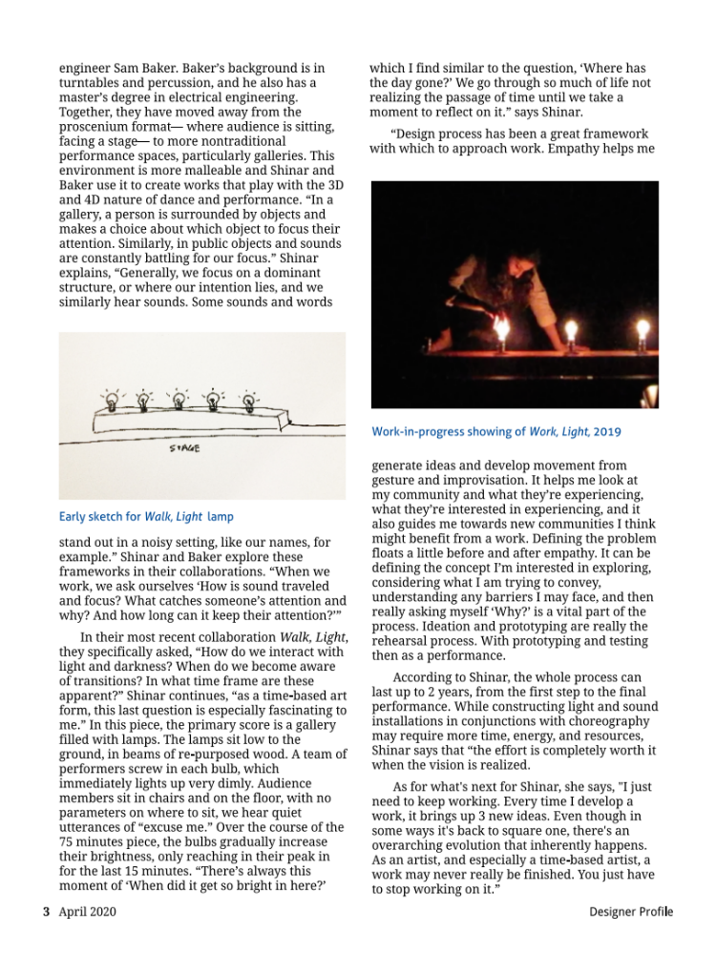
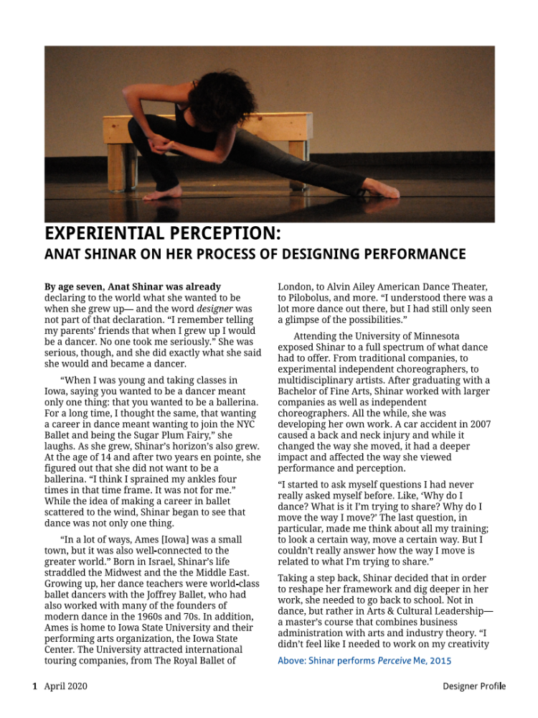
Paper 2: ON SELF AS DEsignER

Slide 37
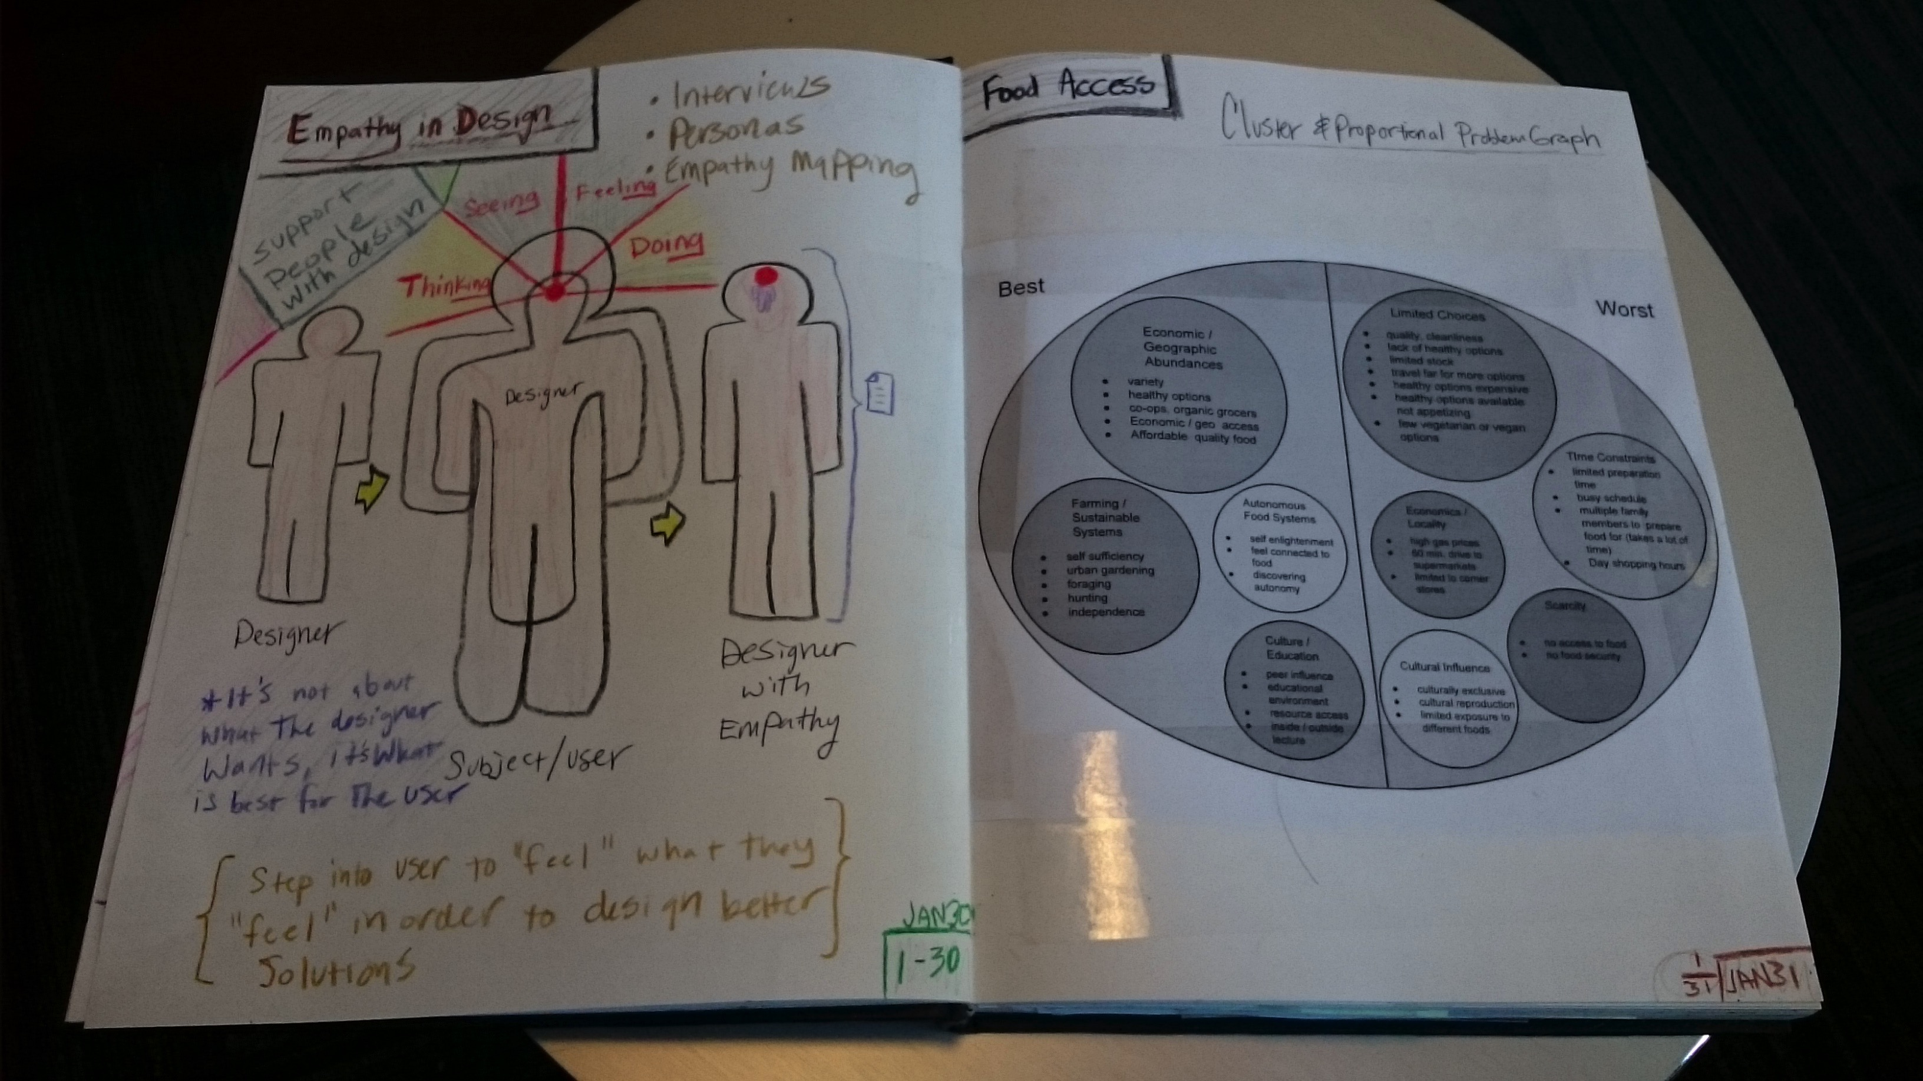
Visual Journal
Scott Fillman
Erin Kober
Exhibited in Rapson library

Slide 38
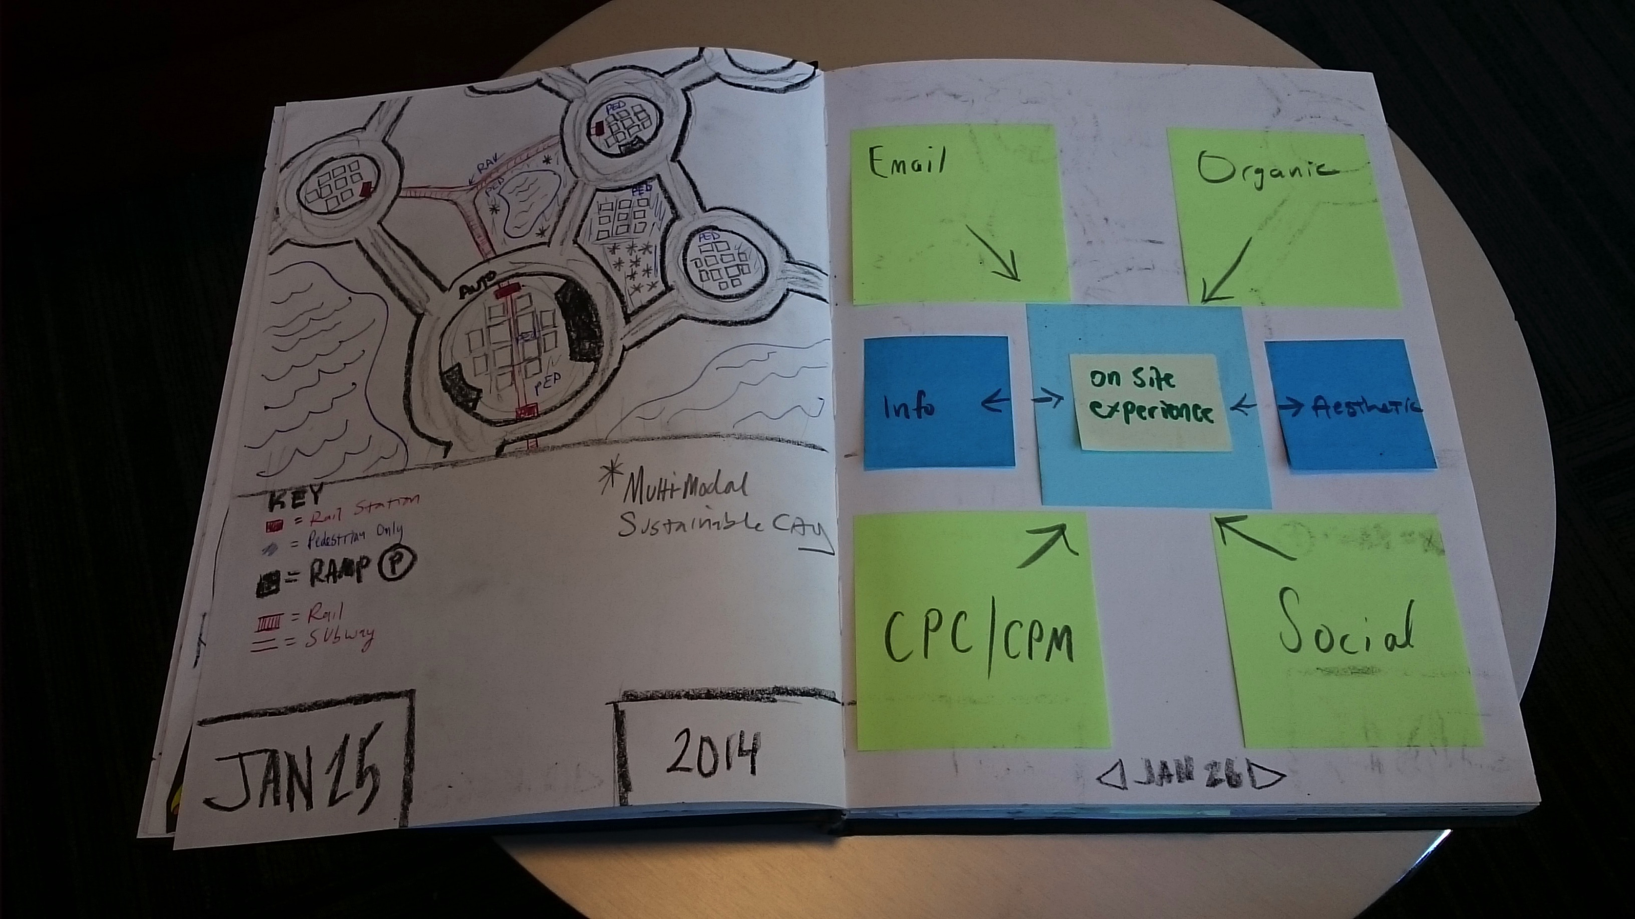
Visual Journal

Slide 39
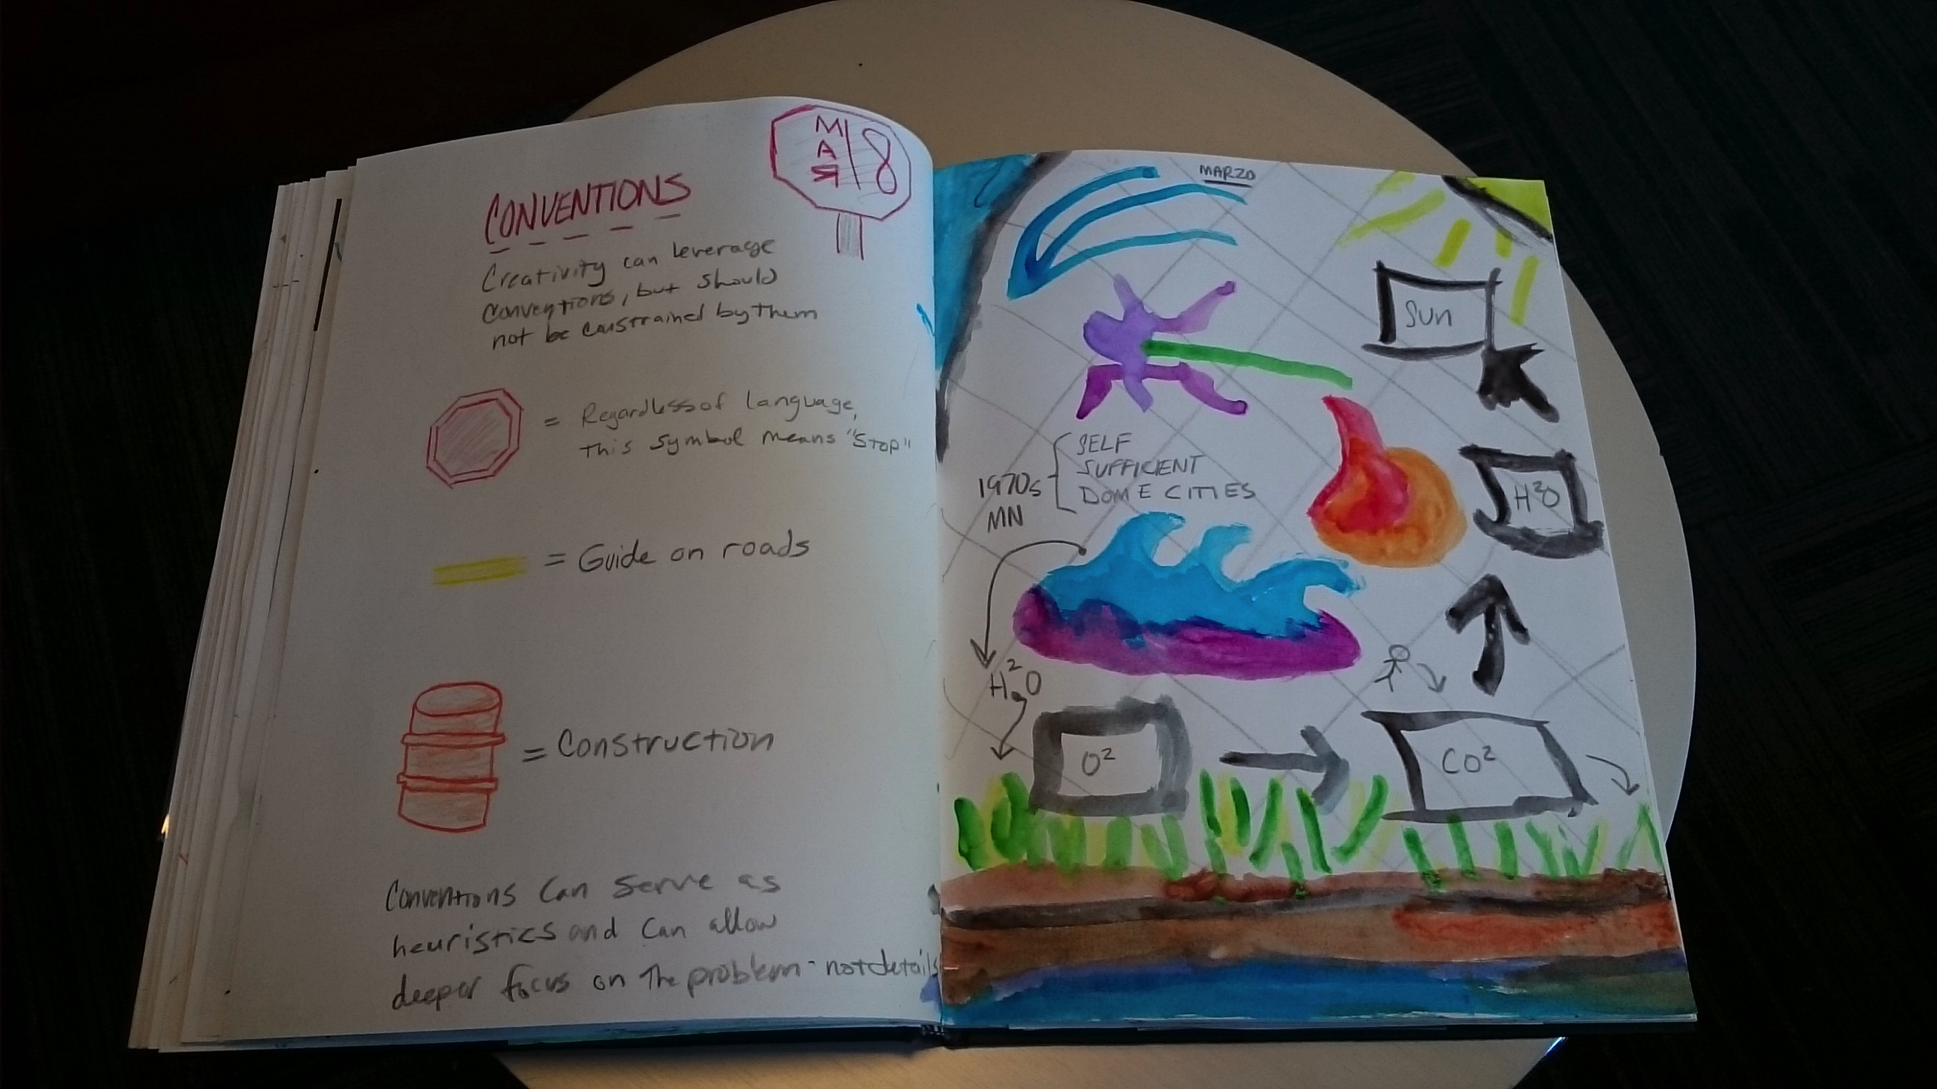
Visual Journal

Slide 40
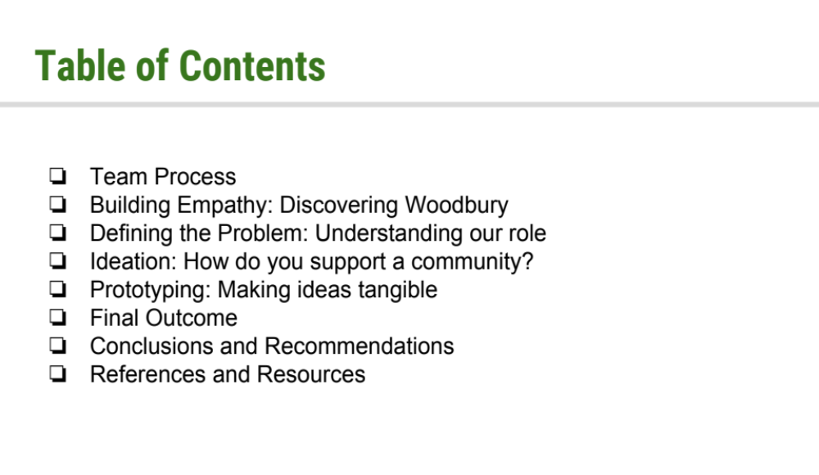
Team Project
Go! Woodbury
HCL

Slide 41
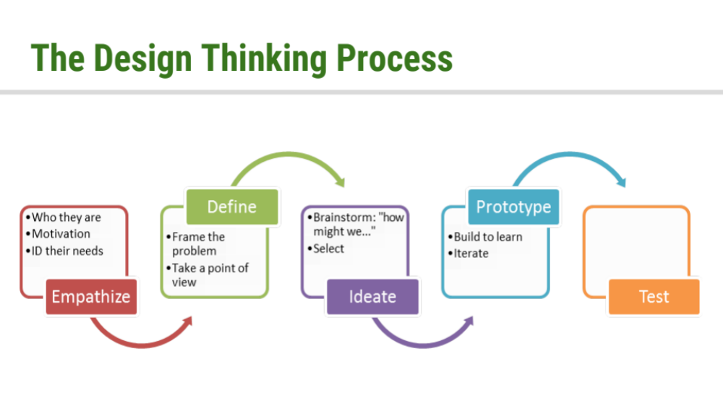
Team Project

Slide 42
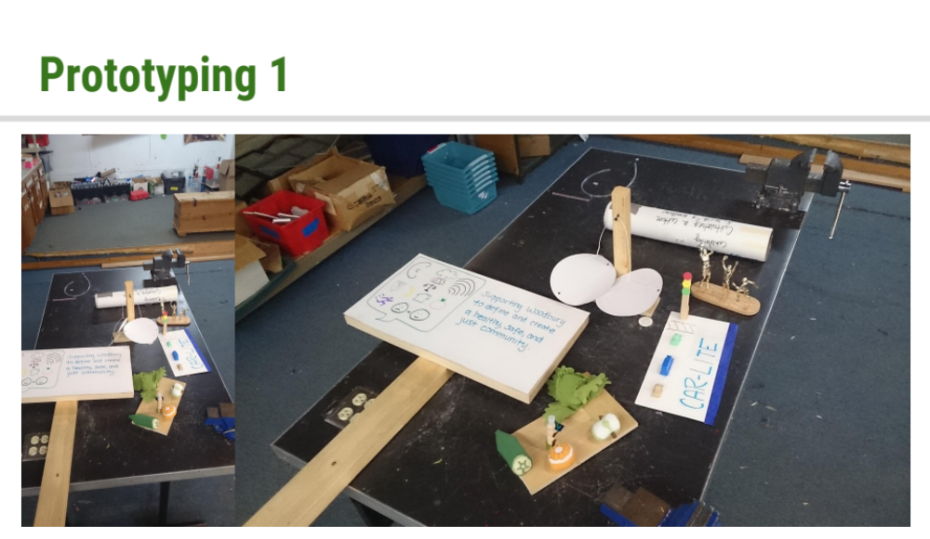
Team Project

Slide 43
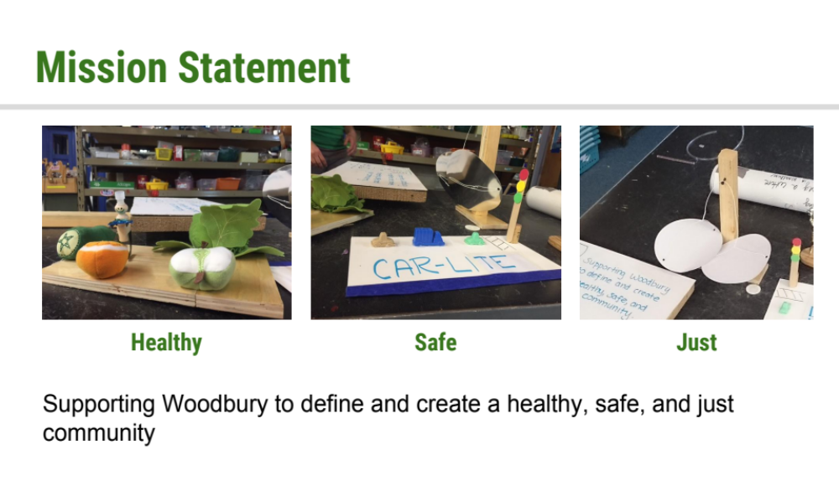
Team Project

Slide 44
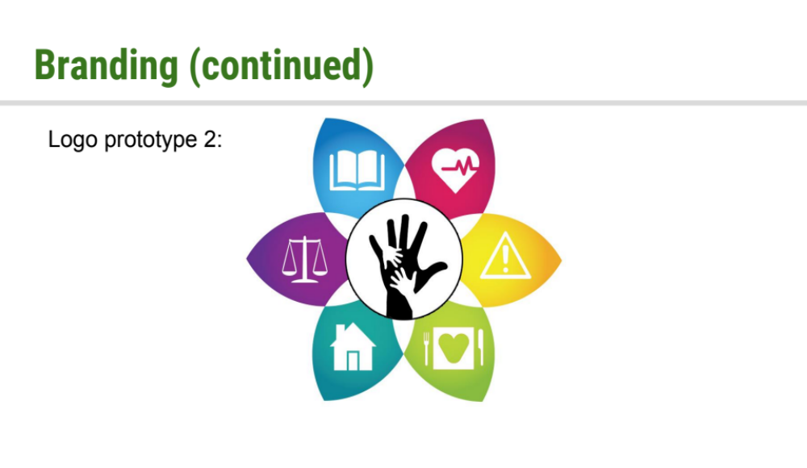
Team Project

Slide 45
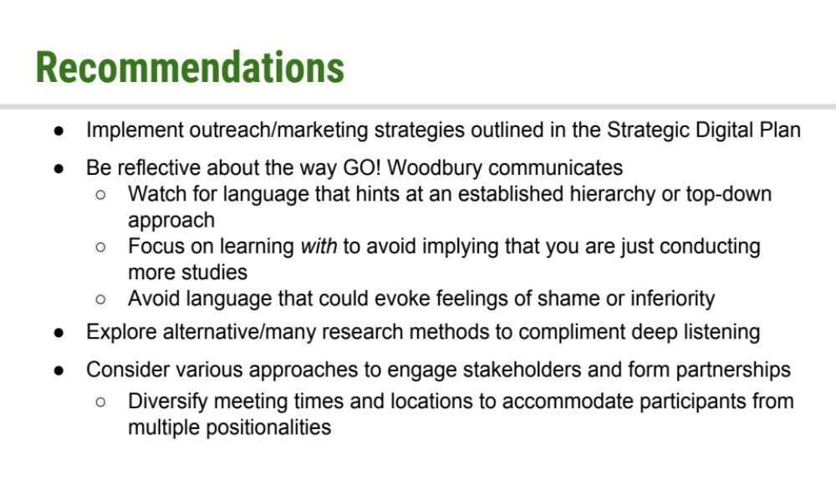
Team Project

Slide 46
Team Project – Student Reflection
‘The introduction of the project by Albert, our primary contact for the “Culture of Health in Woodbury” initiative, left me with the impression that the initiative was in a very early phase of development. It appeared that the team responsible for the initiative had yet to begin defining and articulating their purpose in a tangible and specific nature. The broad and nebulous talking points that existed as the “pitch” for the initiative left us with more questions than answers. It quickly became clear that the lack of a brand and specific details about the mission, service areas, and story of the initiative likely left potential donors or partners unsettled. It is difficult to back something that seems ambiguous - no one wants to volunteer or throw money toward something that they can’t grasp.’

Slide 47
Outcome Examples
Influencing student careers
Contributing to systems change
--
Partner success
Minneapolis Institute of Arts Exhibit
Hennepin County Library Patron Experiences

Slide 48
In
Conclusion

Slide 49
Application Possibilities
Use DT to organize your course
Use DT to structure a student team project
Use particular steps of DT to strengthen aspects of course/projects
Use DT to infuse and expand creativity of student work
Use DT to serve problem solving and address grand challenges in our society

Slide 50
Questions/Comments?

Slide 51
Thank you!
Design Thinking for Innovation
VIRAJITA SINGH singh023@umn.edu

